Slide 1
Data Structures and Algorithm Analysis
Graphs and Breadth First Search
Lecture 14:
Department of Computer Science & Technology Beijing Normal – Hong Kong Baptist University

Slide 2
Graphs
Extremely useful tool in modeling problems
Consist of:
Vertices
Edges
Vertices can be considered “sites” or locations.
Edges represent
connections.
D
E
C
A
F
B
Vertex
Edge

Slide 3
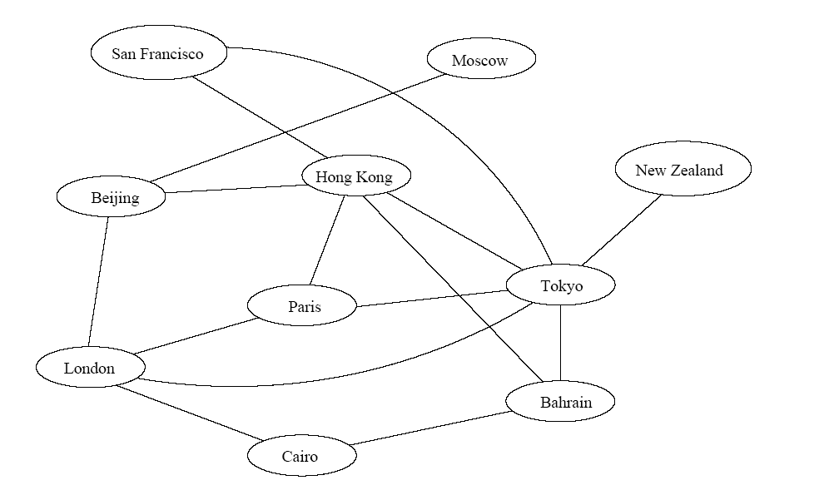
Application 1
Air flight system
Each vertex represents a city
Each edge represents a direct flight between two cities
A query on direct flights = a query on whether an edge exists
A query on how to get to a location = does a path exist from A to B?
We can even associate costs to edges (weighted graphs), then ask “what is the cheapest path from A to B?”

Slide 4
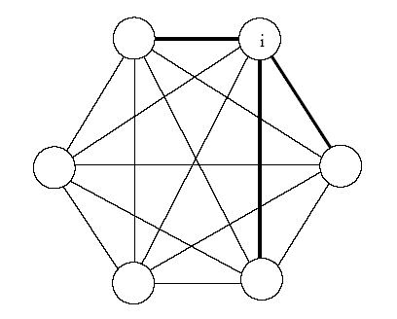
Application 2
Represented by a weighted complete graph (every two vertices are connected by an edge)
Each edge represents the Euclidean distance d_{ij} between two radio stations
Each station uses a certain power i to transmit messages. Given this power i, only a few nodes can be reached (bold edges). A station reachable by i then uses its own power to relay the message to other stations not reachable by i.
A typical wireless communication problem is: how to broadcast between all stations such that they are all connected and the power consumption is minimized.

Slide 5
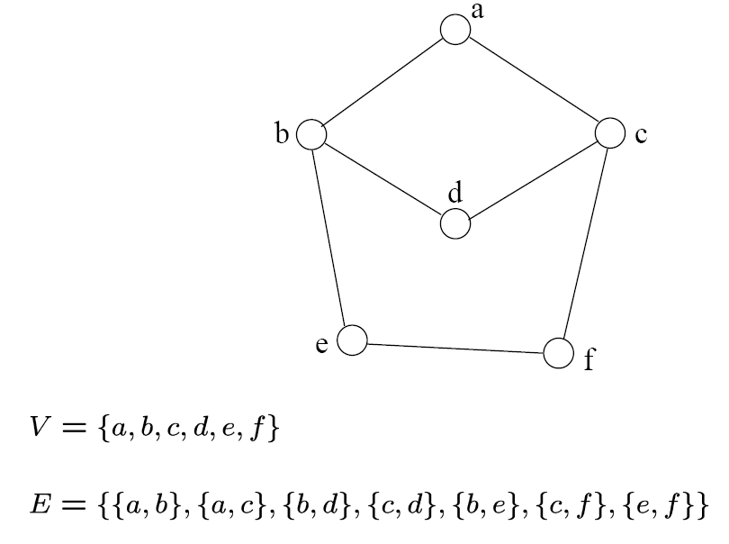
Definition
A graph G=(V, E) consists a set of vertices V and a set of edges E.
Each edge is a pair of (v, w) where v and w belong to V
If the pair is unordered, the graph is undirected; otherwise it is directed
{a,b}
{a,c}
{b,d}
{c,d}
{b,e}
{c,f}
{e,f}
An undirected graph

Slide 6
Terminology
If v₁ and v₂ are connected, they are said to be adjacent vertices
v₁ and v₂ are endpoints of the edge {v₁, v₂}
If an edge e is connected to v then v is said to be incident on e. Also, the edge e is said to be incident on v.
{v₁, v₂} = {v₂, v₁}
If we are talking about directed graphs, where edges have direction, then {v₁,v₂} ≠ {v₂,v₁} Directed graphs are drawn with arrows (called arcs) between edges.
A
B
This means {A,B} only, not {B,A}

Slide 7
Graph Representation
Two popular computer representations of a graph. Both represent the vertex set and the edge set, but in different ways.
Adjacency Matrix
Use a 2D matrix to represent the graph
Adjacency List
Use a 1D array of linked lists

Slide 8
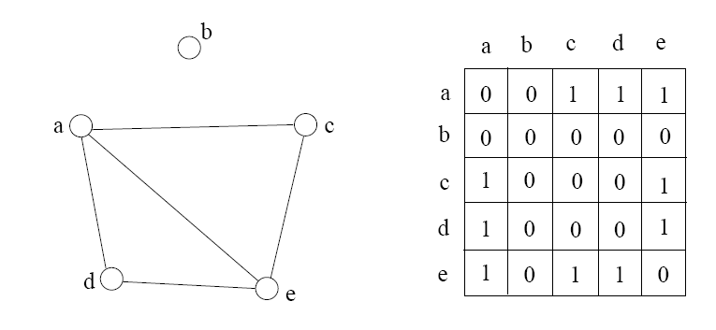
Adjacency Matrix
2D array A[0..n-1, 0..n-1], where n is the number of vertices in the graph.
Each row and column is indexed by the vertex id
e,g a=0, b=1, c=2, d=3, e=4
A[i][j]=1 if there is an edge connecting vertices i and j
otherwise A[i][j]=0.
The storage requirement is Θ(n²). It is not efficient if the graph has few edges. An adjacency matrix is an appropriate representation if the graph is dense: |E|=Θ(|V|²)
We can detect in O(1) time whether two vertices are connected.

Slide 9
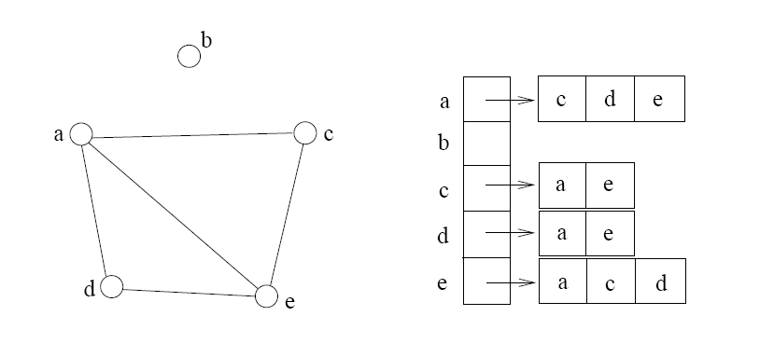
Adjacency List
If the graph is not dense, in other words, sparse, a better solution is an adjacency list
The adjacency list is an array A[0..n-1] of lists, where n is the number of vertices in the graph.
Each array entry is indexed by the vertex id
Each list A[i] stores the ids of the vertices adjacent to vertex i

Slide 10
Adjacency Matrix Example
0
 | 0 | 1 | 2 | 3 | 4 | 5 | 6 | 7 | 8 | 9
0 | 0 | 0 | 0 | 0 | 0 | 0 | 0 | 0 | 1 | 0
1 | 0 | 0 | 1 | 1 | 0 | 0 | 0 | 1 | 0 | 1
2 | 0 | 1 | 0 | 0 | 1 | 0 | 0 | 0 | 1 | 0
3 | 0 | 1 | 0 | 0 | 1 | 1 | 0 | 0 | 0 | 0
4 | 0 | 0 | 1 | 1 | 0 | 0 | 0 | 0 | 0 | 0
5 | 0 | 0 | 0 | 1 | 0 | 0 | 1 | 0 | 0 | 0
6 | 0 | 0 | 0 | 0 | 0 | 1 | 0 | 1 | 0 | 0
7 | 0 | 1 | 0 | 0 | 0 | 0 | 1 | 0 | 0 | 0
8 | 1 | 0 | 1 | 0 | 0 | 0 | 0 | 0 | 0 | 1
9 | 0 | 1 | 0 | 0 | 0 | 0 | 0 | 0 | 1 | 0
8
2
9
1
3
7
6
4
5

Slide 11
Adjacency List Example
0
0
1
2
3
4
5
6
7
8
9
8
2 | 3 | 7 | 9
8
1 | 4 | 8
2
9
1 | 4 | 5
1
2 | 3
7
3 | 6
3
6
5 | 7
4
5
1 | 6
0 | 2 | 9
1 | 8

Slide 12
Storage of Adjacency List
The array takes up Θ(n) space
Define degree of v, deg(v), to be the number of edges incident to v. Then, the total space to store the lists is proportional to:
An edge e={u,v} of the graph contributes a count of 1 to deg(u) and contributes a count of 1 to deg(v)
Therefore Σ_{vertex v}deg(v) = 2m where m is the total number of edges
In all, the adjacency list takes up Θ(n+m) space
If m = O(n²) (i.e. dense graphs), both the adjacency matrix and the adjacency list use Θ(n²) space.
If m = O(n), the adjacency list outperforms the adjacency matrix
However, with an adjacency list one cannot tell in O(1) time whether two vertices are connected! A linked list search is required.

Slide 13
Adjacency List vs. Matrix
Adjacency List
More compact than adjacency matrices if graph has few edges
Requires more time to find if an edge exists
Adjacency Matrix
Always require n² space
This can waste a lot of space if the graph is sparse
Can quickly find if an edge exists

Slide 14
Path between Vertices
A path is a sequence of vertices (v₀, v₁, v₂,… v_{k}) such that:
For 0 ≤ i < k, {v_{i}, v_{i+1}} is an edge
Note: a path is allowed to go through the same vertex or the same edge any number of times!
The length of a path is the number of edges on the path

Slide 15
Types of paths
A path is simple if and only if it does not contain a vertex more than once.
A path is a cycle if and only if v₀= v_{k}
The beginning and end are the same vertex!
A path contains a cycle as its sub-path if some vertex appears twice or more

Slide 16
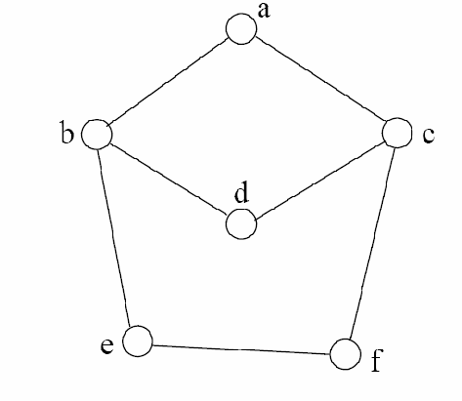
Path Examples
Are these paths?
Any cycles?
What is the path’s length?
{a,c,f,e}
{a,b,d,c,f,e}
{a, c, d, b, d, c, f, e}
{a,c,d,b,a}
{a,c,f,e,b,d,c,a}

Slide 17
Graph Traversal
Application example
Given a graph representation and a vertex s in the graph
Find all paths from s to other vertices
Two common graph traversal algorithms
Breadth-First Search (BFS)
Find the shortest paths in an unweighted graph
Depth-First Search (DFS)
Topological sort
Find strongly connected components

Slide 18
BFS and Shortest Path Problem
Given any source vertex s, BFS visits the other vertices at increasing distances away from s. In doing so, BFS discovers paths from s to other vertices
What do we mean by “distance”? The number of edges on a path from s
Example
0
Consider s = vertex 1
8
2
Nodes at distance 1?
2, 3, 7, 9
1
2
s
9
1
1
Nodes at distance 2?
8, 6, 5, 4
7
1
3
6
2
4
1
5
Nodes at distance 3?
0
2
2

Slide 19
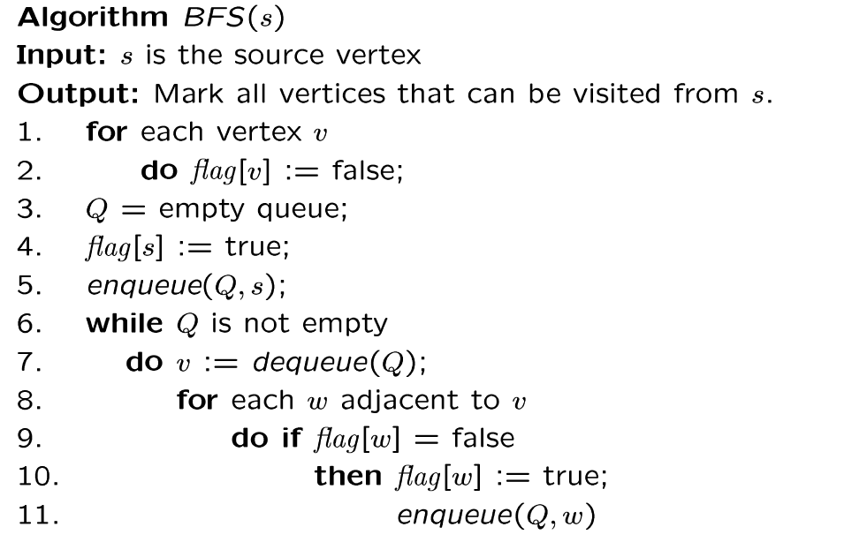
BFS Algorithm
// flag[ ]: visited table
Why use queue? Need FIFO

Slide 20
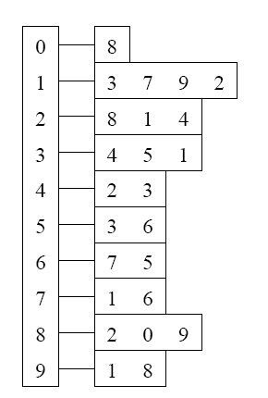
BFS Example
Adjacency List
Visited Table (T/F)
0
0
1
2
3
4
5
6
7
8
9
F
F
F
F
F
F
F
F
F
F
8
source
2
9
1
3
7
6
4
5
Initialize visited
table (all False)
Q =
{ }
Initialize Q to be empty

Slide 21
BFS Example (Cont’d)
Adjacency List
Visited Table (T/F)
0
0
1
2
3
4
5
6
7
8
9
F
F
T
F
F
F
F
F
F
F
8
source
2
9
1
3
7
6
4
5
Flag that 2 has
been visited
Q =
{ 2 }
Place source 2 on the queue

Slide 22
BFS Example (Cont’d)
Adjacency List
Visited Table (T/F)
0
0
1
2
3
4
5
6
7
8
9
F
T
T
F
T
F
F
F
T
F
8
Neighbors
source
2
9
1
3
7
6
4
5
Mark neighbors
as visited 1, 4, 8
Q =
{2} → { 8, 1, 4 }
Dequeue 2.
Place all unvisited neighbors of 2 on the queue

Slide 23
BFS Example (Cont’d)
Adjacency List
Visited Table (T/F)
0
0
1
2
3
4
5
6
7
8
9
T
T
T
F
T
F
F
F
T
T
8
source
2
9
1
3
7
6
4
5
Neighbors
Mark new visited
Neighbors 0, 9
Q =
{ 8, 1, 4 } → { 1, 4, 0, 9 }
Dequeue 8.
-- Place all unvisited neighbors of 8 on the queue.
-- Notice that 2 is not placed on the queue again, it has been visited!

Slide 24
BFS Example (Cont’d)
Adjacency List
Visited Table (T/F)
0
0
1
2
3
4
5
6
7
8
9
T
T
T
T
T
F
F
T
T
T
8
Neighbors
source
2
9
1
3
7
6
4
5
Mark new visited
Neighbors 3, 7
Q =
{ 1, 4, 0, 9 } → { 4, 0, 9, 3, 7 }
Dequeue 1.
-- Place all unvisited neighbors of 1 on the queue.
-- Only nodes 3 and 7 haven’t been visited yet.

Slide 25
BFS Example (Cont’d)
Adjacency List
Visited Table (T/F)
0
0
1
2
3
4
5
6
7
8
9
T
T
T
T
T
F
F
T
T
T
8
source
2
9
1
Neighbors
3
7
6
4
5
Q =
{ 4, 0, 9, 3, 7 } → { 0, 9, 3, 7 }
Dequeue 4.
-- 4 has no unvisited neighbors!

Slide 26
BFS Example (Cont’d)
Adjacency List
Visited Table (T/F)
0
0
1
2
3
4
5
6
7
8
9
T
T
T
T
T
F
F
T
T
T
Neighbors
8
source
2
9
1
3
7
6
4
5
Q =
{ 0, 9, 3, 7 } → { 9, 3, 7 }
Dequeue 0.
-- 0 has no unvisited neighbors!

Slide 27
BFS Example (Cont’d)
Adjacency List
Visited Table (T/F)
0
0
1
2
3
4
5
6
7
8
9
T
T
T
T
T
F
F
T
T
T
8
source
2
9
1
3
7
6
4
5
Neighbors
Q =
{ 9, 3, 7 } → { 3, 7 }
Dequeue 9.
-- 9 has no unvisited neighbors!

Slide 28
BFS Example (Cont’d)
Adjacency List
Visited Table (T/F)
0
0
1
2
3
4
5
6
7
8
9
T
T
T
T
T
T
F
T
T
T
8
source
2
9
Neighbors
1
3
7
6
4
5
Mark new visited
Vertex 5
Q =
{ 3, 7 } → { 7, 5 }
Dequeue 3.
-- place neighbor 5 on the queue.

Slide 29
BFS Example (Cont’d)
Adjacency List
Visited Table (T/F)
0
1
2
3
4
5
6
7
8
9
T
T
T
T
T
T
T
T
T
T
0
8
source
2
9
1
3
7
Neighbors
6
4
5
Mark new visited
Vertex 6
Q =
{ 7, 5 } → { 5, 6 }
Dequeue 7.
-- place neighbor 6 on the queue

Slide 30
BFS Example (Cont’d)
Adjacency List
Visited Table (T/F)
0
0
1
2
3
4
5
6
7
8
9
T
T
T
T
T
T
T
T
T
T
8
source
2
9
1
Neighbors
3
7
6
4
5
Q =
{ 5, 6} → { 6 }
Dequeue 5.
-- no unvisited neighbors of 5

Slide 31
BFS Example (Cont’d)
Adjacency List
Visited Table (T/F)
0
0
1
2
3
4
5
6
7
8
9
T
T
T
T
T
T
T
T
T
T
8
source
2
9
1
3
7
Neighbors
6
4
5
Q =
{ 6 } → { }
Dequeue 6.
-- no unvisited neighbors of 6

Slide 32
BFS Example (Cont’d)
Adjacency List
Visited Table (T/F)
0
0
1
2
3
4
5
6
7
8
9
T
T
T
T
T
T
T
T
T
T
8
source
2
9
1
3
7
6
4
5
What did we discover?
Look at “visited” tables.
There exists a path from source
vertex 2 to all vertices in the graph
Q =
{ }
STOP!!! Q is empty!!!

Slide 33
Time Complexity of BFS (Using Adjacency List)
Assume adjacency list
n = number of vertices m = number of edges
O(n + m)
Each vertex will enter Q at most once.
Each iteration takes time proportional to deg(v) + 1 (the number 1 is to account for the case where deg(v) = 0 --- the work required is 1, not 0).

Slide 34
Running Time
Total time for the enqueue and deqeue operations: O(n)
Recall: Given a graph with m edges, what is the total degree?
Total time for processing adjacent vertices:
This is summing over all the iterations in the while loop!
The total running time is then: O(n + m)
Σ_{vertex v} deg(v) = 2m
O( Σ_{vertex v} (deg(v) + 1) ) = O(m)

Slide 35
Time Complexity of BFS (Using Adjacency Matrix)
Assume adjacency list
n = number of vertices m = number of edges
O(n²)
Finding the adjacent vertices of v requires checking all elements in the matrix row. This takes linear time O(n).
Summing over all the n iterations, the total running time is O(n²).

Slide 36
Time Complexity of BFS
When using an adjacency matrix, BFS is O(n²), independent of the number of edges m.
When using an adjacency list, BFS is O(n + m).
If the graph is dense then m = O(n²) and then O(n + m)=O(n²).

